Slide 1
The Fish
used for solving complex proportions

Slide 2
Proportion problems like these can always be solved by using cross multiplication:
$$\frac{8}{15}=\frac{x}{20}$$
$=15·x$
$160=15x$
$10.67=x$
$$8·20$$
$15 15$

Slide 3
Divide vertically, straight up or down. 17 x 9 ÷ 2.5
Then draw a diagonal line and push the enter, or Equal key. 17 x 9 ÷ 2.5 = x
The Fish is easy to put into a calculator and quickly solves complex proportions. Just remember, “multiply-divide-equals.”
Start on the side with the variable, but not at the variable.
Each of the steps in cross multiplying can be found in an easier method we call “The Fish.”
Multiply diagonally across the equal sign. 17 x 9.
$$\frac{2.5}{9}=\frac{17}{x}$$
$$=61.2$$

Slide 4
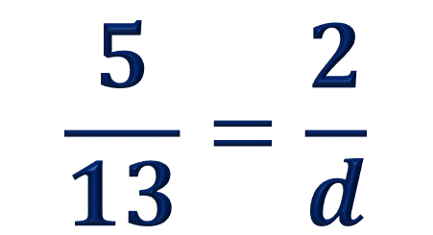
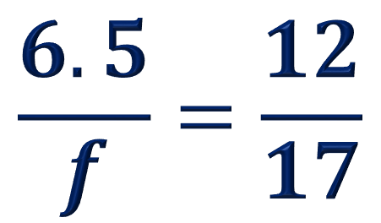
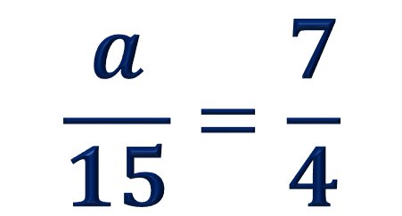
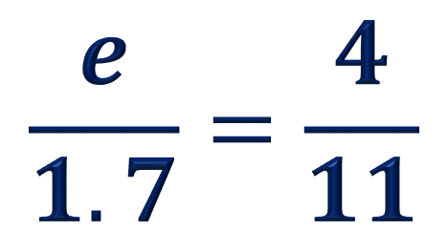
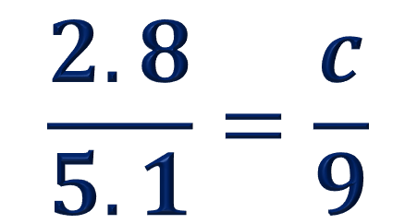
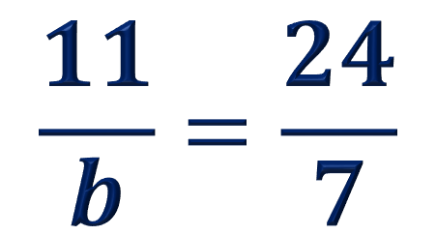
You try.
$$\frac{a}{15}=\frac{7}{4}$$
$$\frac{11}{b}=\frac{24}{7}$$
$$\frac{2.8}{5.1}=\frac{c}{9}$$
$$\frac{5}{13}=\frac{2}{d}$$
$$\frac{e}{1.7}=\frac{4}{11}$$
$$\frac{6.5}{f}=\frac{12}{17}$$

