Slide 1
Rainbow Rainbow
used for solving simple proportions

Slide 2
Proportion problems like these can always be solved by using cross multiplication:
$$\frac{8}{15}=\frac{x}{20}$$
$=15·x$
$160=15x$
$10.67=x$
$$8·20$$
$15 15$

Slide 3



Then multiply 7 by 3.
To get from 5 to 15, we multiply by 3.
In this case, 5 and 15 are both divisible by 5. Draw a rainbow between them and another below.
Many proportion problems are simple and can be solved by a method I call “Rainbow Rainbow.”
Look for relationships among numbers -- common factors.
$$×3$$
$$\frac{5}{7}=\frac{15}{x}$$
$$=21$$
$$×3$$

Slide 4



This time instead of multiplying, we divide … by 4.
Sometimes the relationships are vertical. Put an arrow on the end of the rainbow, and point toward the variable.
$$\frac{8}{2}=\frac{44}{x}$$
$$÷4$$
$$÷4$$
$$=11$$

Slide 5
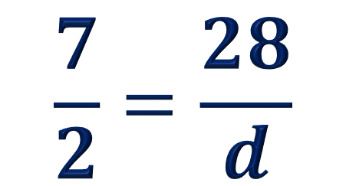
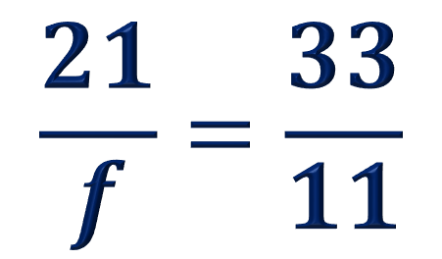
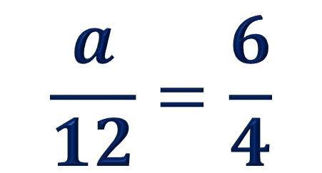
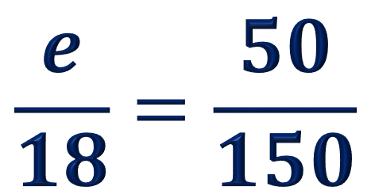
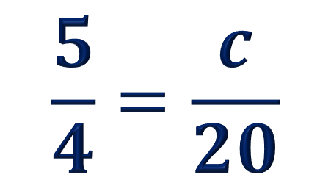
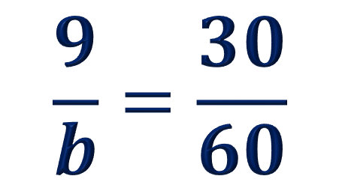
You try.
$$\frac{a}{12}=\frac{6}{4}$$
$$\frac{9}{b}=\frac{30}{60}$$
$$\frac{5}{4}=\frac{c}{20}$$
$$\frac{7}{2}=\frac{28}{d}$$
$$\frac{e}{18}=\frac{50}{150}$$
$$\frac{21}{f}=\frac{33}{11}$$

