Slide 1
Now name the rest,
by how they’re dressed.
I am Pi.
Who am I?

Slide 2
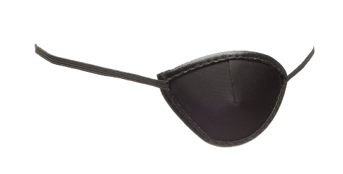
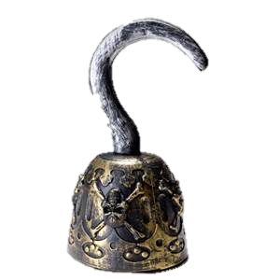
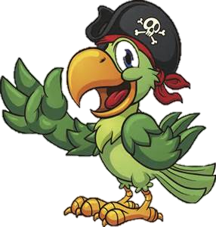

Slide 3
Pi-rate

Slide 4
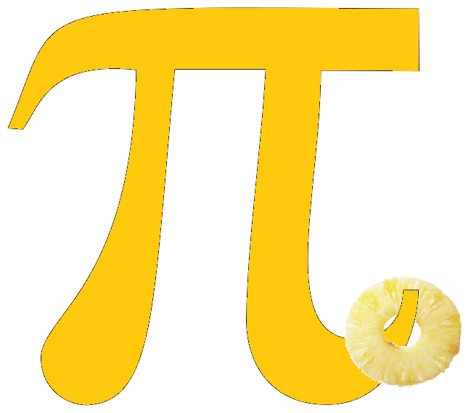

Slide 5
Pi-neapple

Slide 6
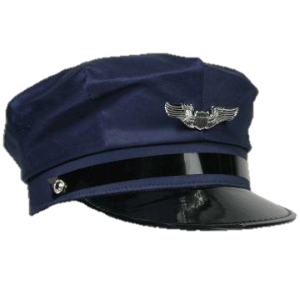

Slide 7
Pi-lot

Slide 8
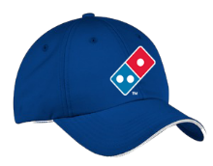
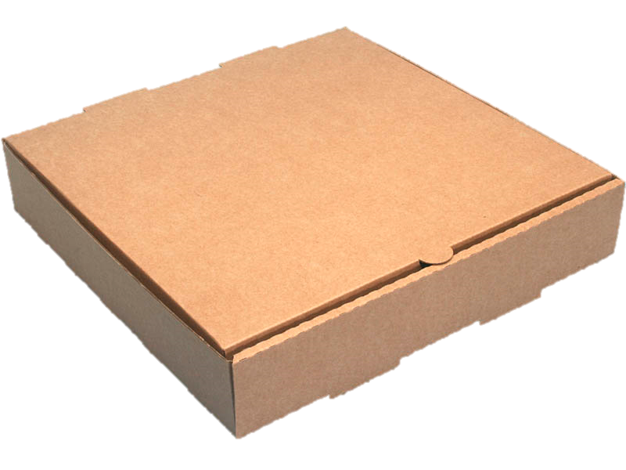

Slide 9
Pi-zza Delivery
Person

Slide 10
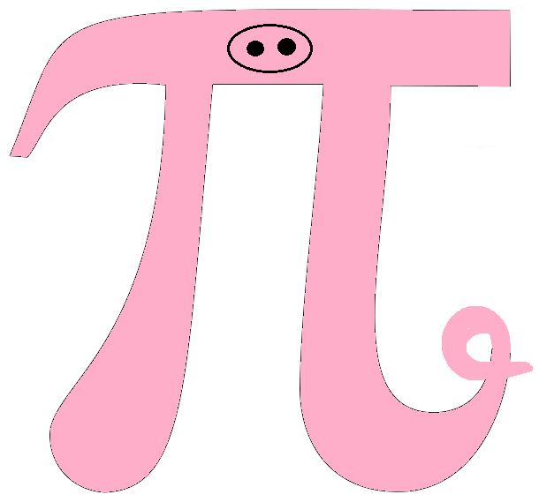
Oink

Slide 11
Pi-g

Slide 12
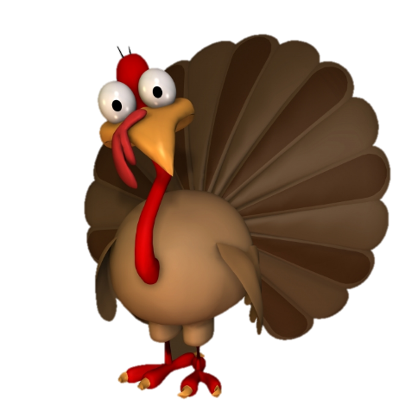

Slide 13
Pi-lgram

Slide 14
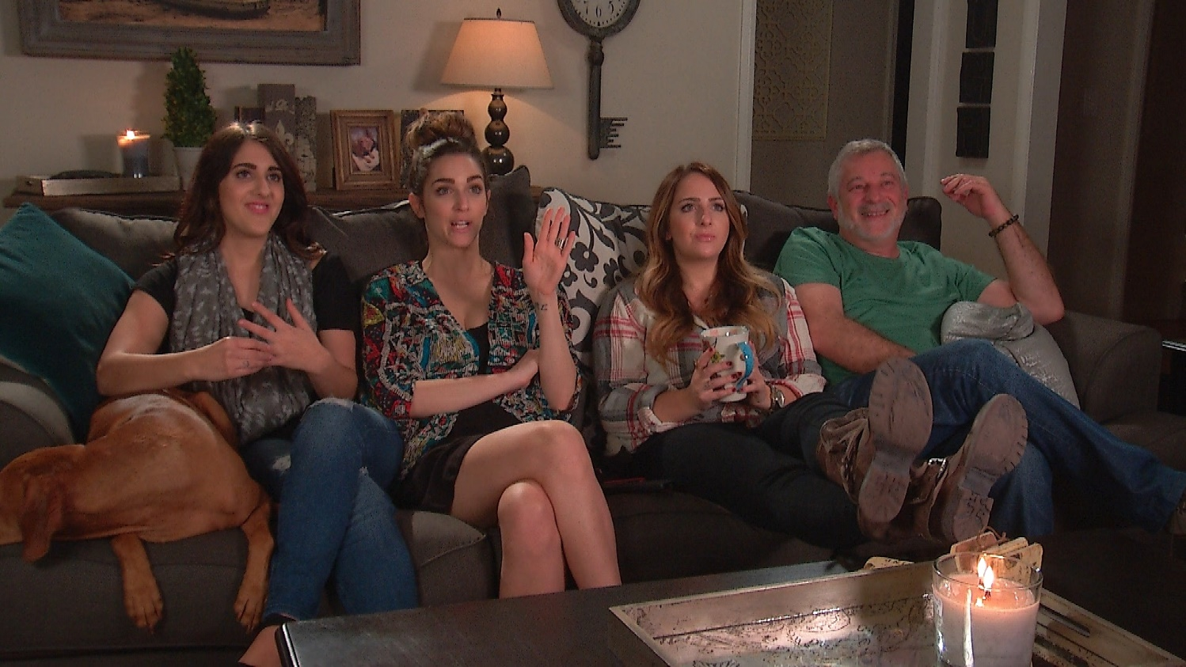
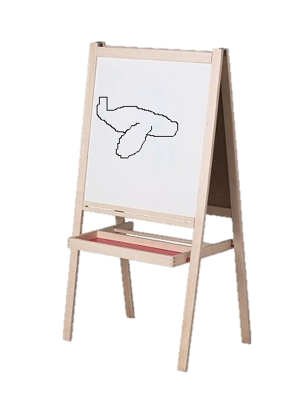
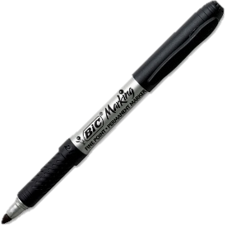

Slide 15
Pi-ctionary
Player

Slide 17
Leaning
Tower
Of Pi-sa

Slide 18
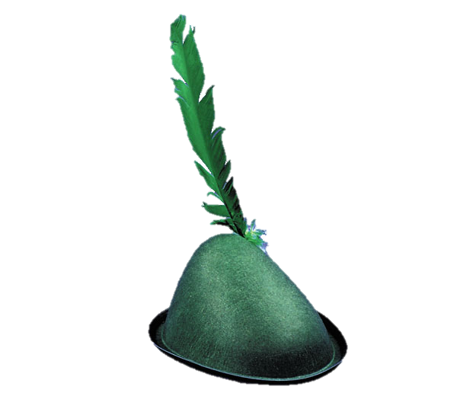
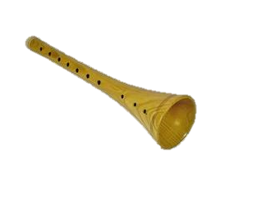
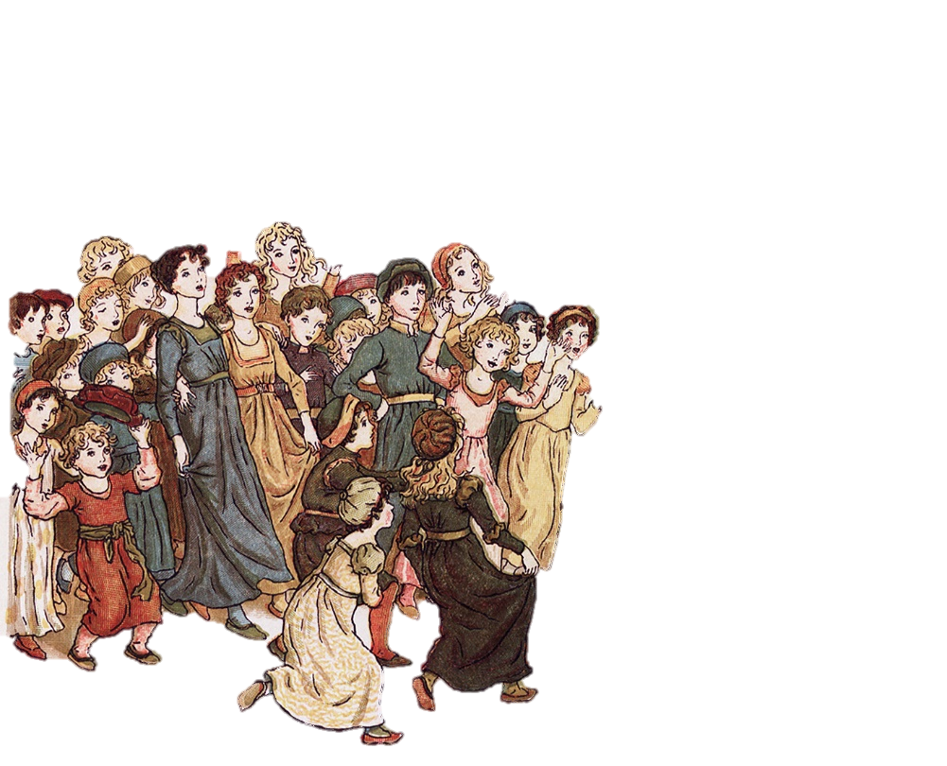

Slide 19
Pi-ed Pi-per

Slide 21
Pi-llow
Fighter

Slide 22
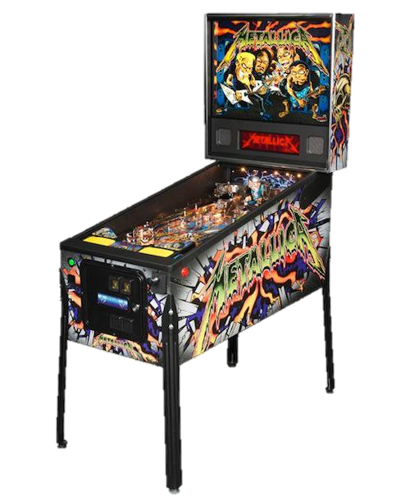
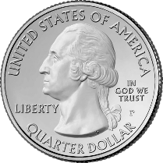

Slide 23
Pi-nball
Player

Slide 24
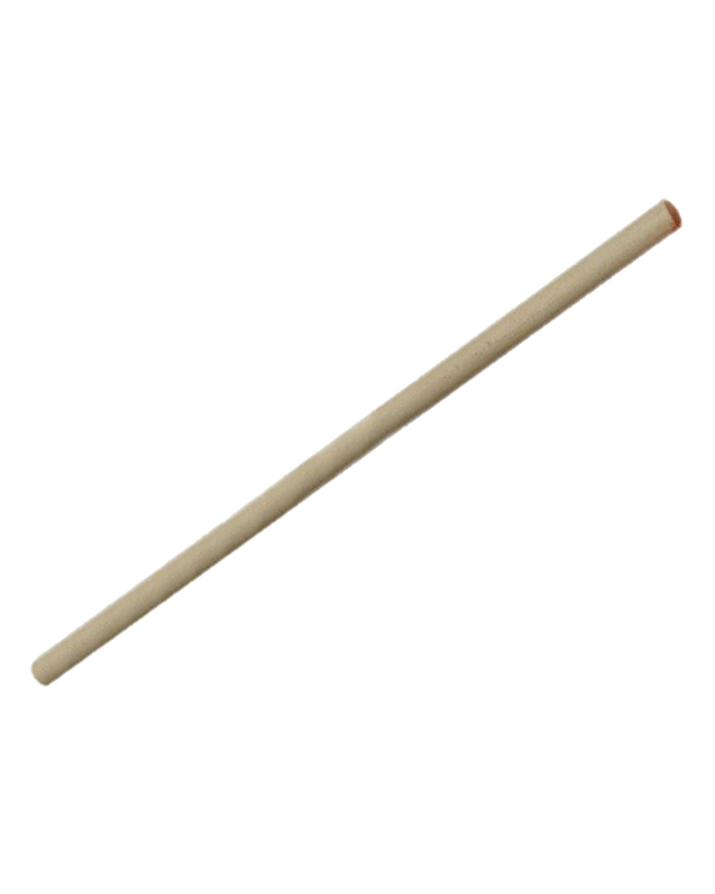
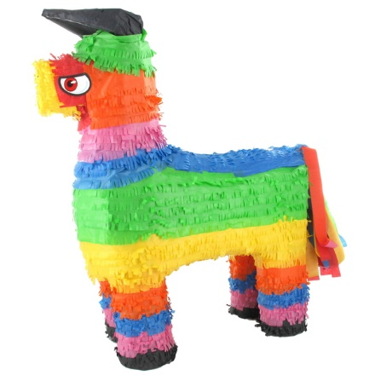
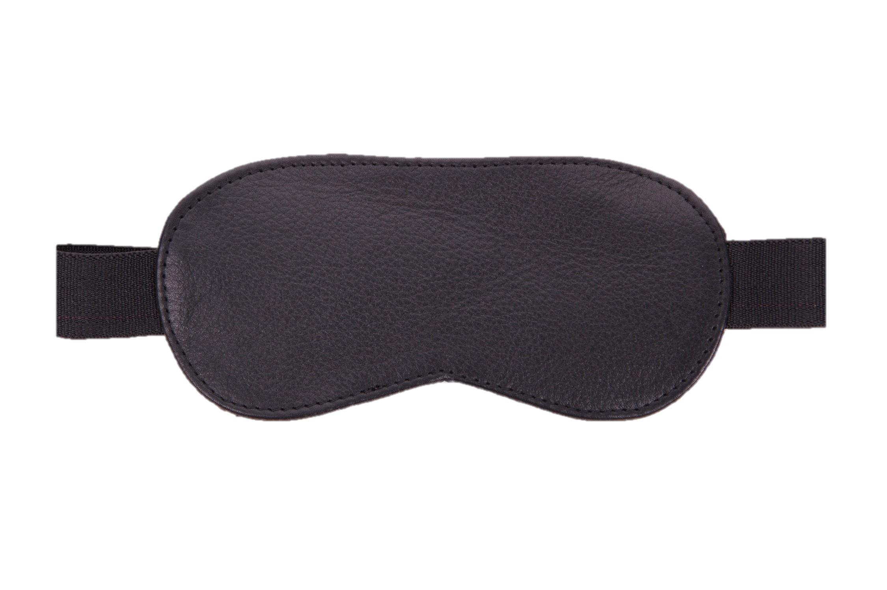

Slide 25
Pi-nata
Buster

Slide 26
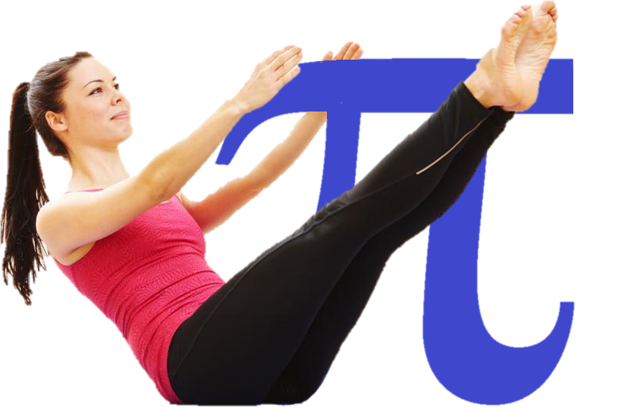

Slide 27
Pi-lates
Instructor

