Slide 1
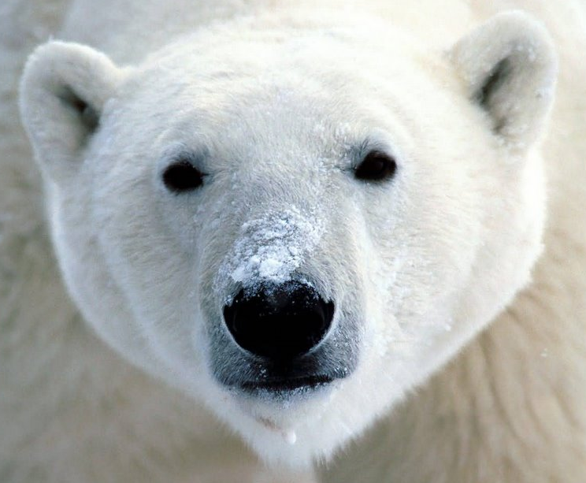
Polar Bears
are Positive
… and so are Penguins

Slide 2
Have you ever wondered why
polar bears don’t
eat penguins?
and penguins live thousands of
miles south of it.
Polar bears live thousands of
miles north of
the equator…
Z
E

Slide 3
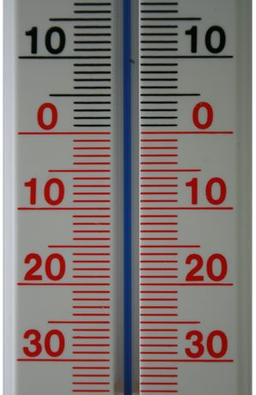
they both live at
positive latitudes.
But even though they
both live in negative temperatures…

Slide 4
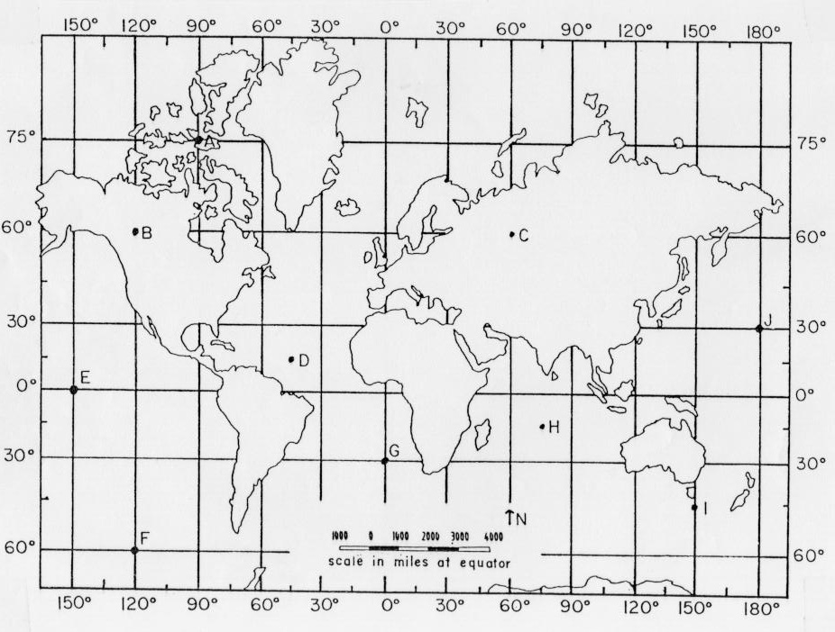
60◦ S
for the birds
opposite directions
but both positive
60◦ N
for the bears

Slide 5
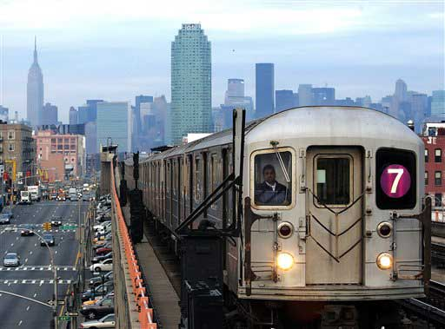
Meanwhile in NYC

Slide 6
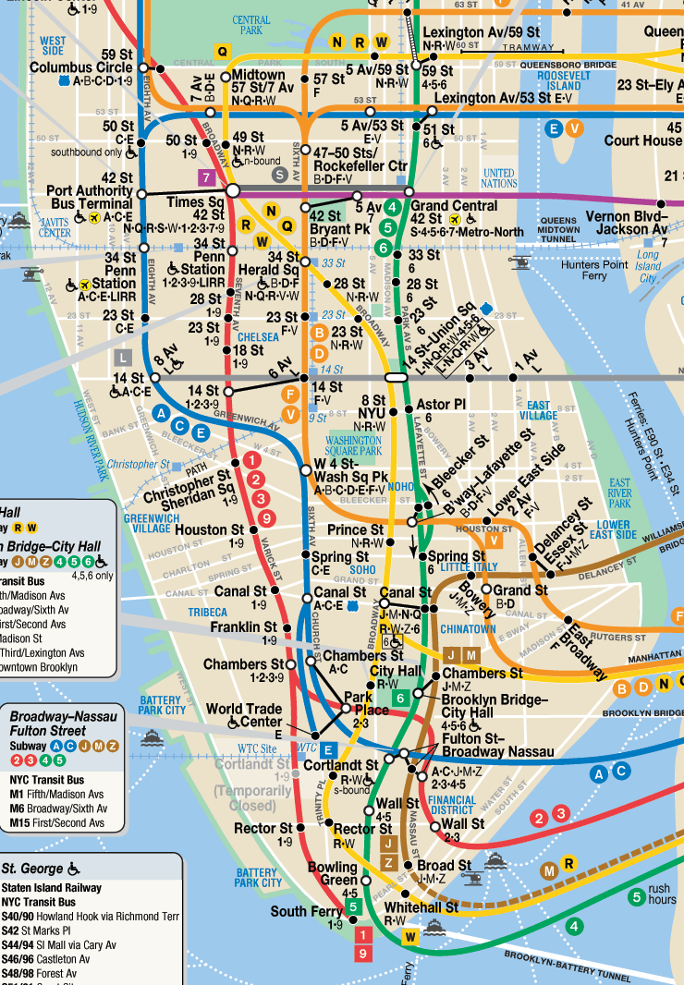
+10
+10
A subway
travels
10 blocks from
40th Street
to
50th Street
Another
travels
10 blocks from
40th Street
to
30th Street
+10
+10

Slide 7
Again…
opposite directions
but both positive

Slide 8
In fact:
There is no
such thing
as a negative
direction

Slide 9
Drive East or
drive West,
your gas tank
gets just as empty.
Pedal North or
pedal South,
your legs get
just as tired.

Slide 10
How far apart
did they finish
from each other?
Leigh pedaled her
bike West four
units on the same
number line.
Ben pedaled his
bike East three
units on a
number line.
seven units
1
2
3
4
5
7
6
0

Slide 11
The absolute value
of a number is the positive value of
that number.
|-4| = 4 |3| = 3

Slide 12
Leigh rode 4 units West.
On a number line, this
is -4. But! There are no negative distances, so
the absolute value is 4.
-4
0

Slide 13
The symbol for absolute value is vertical lines on each side of the number.
|-17| = 17 |15| = 15
-|-12| = -12 -|6| = -6
Algebraically: |-x| = x

Slide 14
Since |-2|=2 and |2|=2, we need to consider two answers for |problems|.
|x - 8| = 12
x - 8 = 12 and x - 8 = - 12
x = 20, - 4

