Slide 1
“Hello Mr. Wunder.”

Slide 2
“Hello Ms. Knoe.
How are you
and your
three lovely
daughters
today?”

Slide 3
“Fine, thank you.”

Slide 4
“How old are they now?”

Slide 5
“The product
of their ages
is 36.”

Slide 6
“Oh, a puzzle.
Give me
another
clue.”

Slide 7
“The sum
of their ages
is on that
mailbox next to you.”

Slide 8
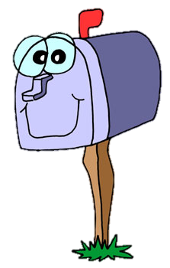
“I see.
Good info,
but I need
one
more
clue.”

Slide 9
“The oldest
one likes
chocolate
ice cream.”

Slide 10
Mr. Wunder now knows. Can you find the ages of
the three
Knoe girls?

